Slide 1
Selfish: Developing Educational Games
Jason Pang 2034852
Gregynog

Slide 2
Content
What is Selfish?
Aimi of the project
The purpose of selfish
Gameplay
How is it educational
Evaluation of existing implementation
Add-ons
Technology used
Progress

Slide 3

What is Selfish?
A game about being a self-fertilizing fish
Base on Mangrove Rivulus
Player mimic the behaviour of fish under certain rules
Attempt their best to get the highest score

Slide 4
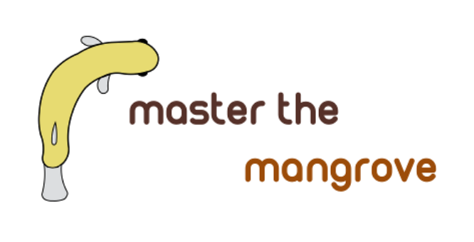
Aim of the project
Take an existing implementation of a Selfish game
perform improvements, add-on as requested by the customer
The customer is a professor in biology department
To study the principle of developing an educational game
Understand what does it means by a good educational game

Slide 5
The purpose of Selfish
To deepens the understanding about behaviour of the fish
To understand how environment and strategy affect the population
Explore the advantages and disadvantages of self-fertilising vs outcross
Have fun as a game
The game serves as a instrument outreaching to the general public

Slide 6
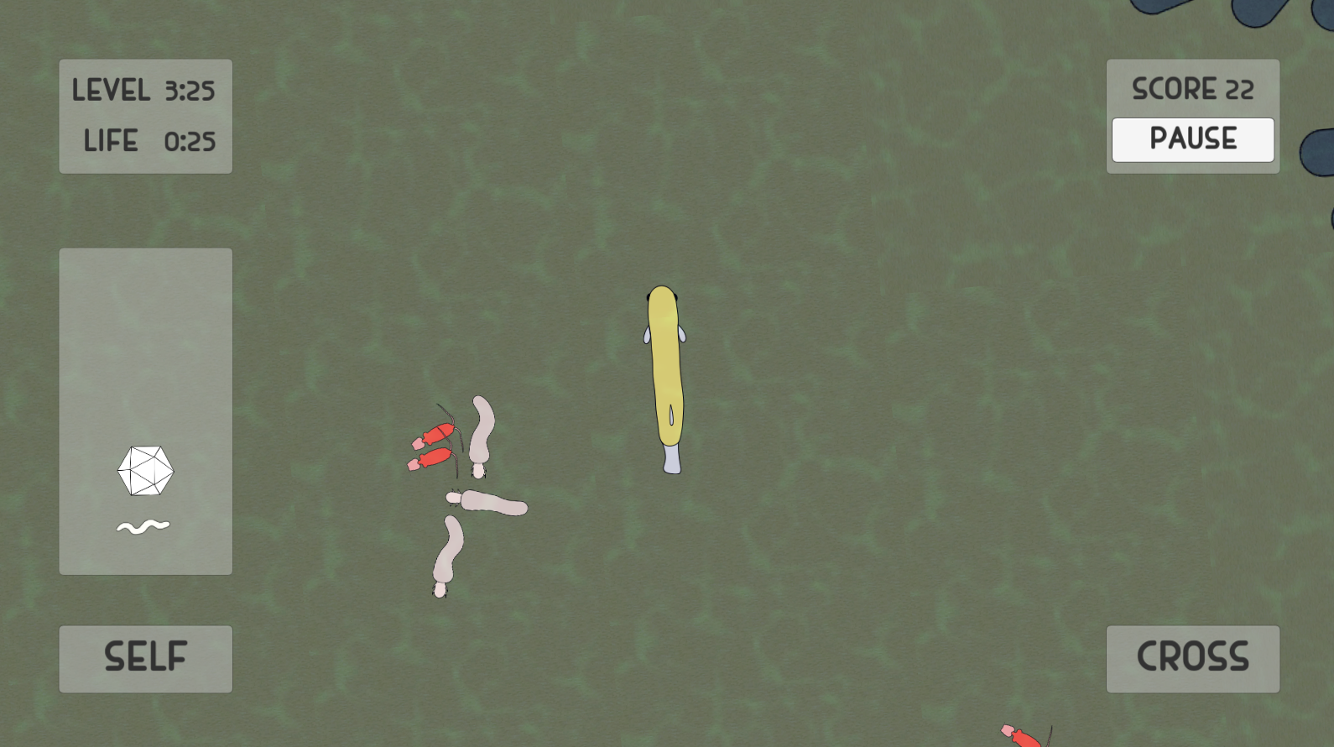
Gameplay
Get score
player control a fish
you are fine with touching these
eat!
beware of pathogens
get immunity
extend bloodline

Slide 7
How is it educational
Interactive
Players need to think about what they need to do in order to achieve highscore
Explore around and make decision base on what the player find to survive
Present infomation in a easily understandable way
No complicated controls
Fully focus on the game
Raise interest around the content
The fish
Or in biology generally

Slide 8
Evaluation of existing implementaion
Provide a basic framework for improvement and add-ons
Working, but not fully
some feature does not work on intended way
perform improvement so it will work

Slide 9
Add-on
Application working on tablet
The game is outreaching to the public
Appear on science festival
Working on mobile devices
Store data and output it to a spreadsheet
Customer request
For research purpose

Slide 10


Technology used
Unity
For developing the application
Original running environment
Bluestacks
One of the most used emulator
For testing if the application is working on a emulator
Should work on tablet if it does

Slide 11
Progess so far
Building an .apk file
working on transfering from PC version to android application
Working on getting features work on the intended way
Reviewing the code and see what went wrong
Fixing what is not working

Slide 12
Thank you

